Slide 1
Employee Data Analysis using Excel
STUDENT NAME: Rajeshwari P
REGISTER NO:312217032
DEPARTMENT: Bcom(general)
COLLEGE:Shri Krishna swamy college

Slide 2
PROJECT TITLE Salary and compensation Ananlysis Through Excel data modeling

Slide 3


AGENDA
Problem Statement
Project Overview
End Users
Our Solution and Proposition
Dataset Description
Modelling Approach
Results and Discussion
Conclusion
3/21/2024 Annual Review

Slide 4

PROBLEM STATEMENT
*Problem Statement:* “Our organization is facing challenges in managing its compensation structure, with concerns about internal equity, market competitiveness, and budget control. As a result, we need to conduct a comprehensive salary and compensation analysis to: 1. Identify trends and disparities in current compensation practices 2. Evaluate internal equity and ensure fair pay for similar roles and performances 3. Develop a data-driven approach to inform compensation decisions and budget planning 4.Create a scalable and sustainable compensation model that aligns with business objectives

Slide 5

PROJECT OVERVIEW
*Project Objective:* To design and develop an Excel-based data model that enables comprehensive analysis of salary and compensation data, providing insights for informed decision-making and ensuring fair and competitive compensation practices.
*Scope:* 1. Data Collection: - Gather salary and compensation data from various sources (HR systems, surveys, market research) 2. Data Modeling: - Design an Excel data model to organize and structure the data

Slide 6

WHO ARE THE END USERS 1. HR Professionals: Responsible for designing and implementing compensation strategies, they will use the analysis to inform decisions and ensure fair pay practices. 2. Compensation Analysts: They will utilize the data model to analyze and interpret compensation data, identifying trends and areas for improvement.

Slide 7

OUR SOLUTION AND ITS VALUE PROPOSITION . *Solution:* A comprehensive Excel-based data model that integrates and analyzes salary and compensation data from various sources

Slide 8
Dataset Description *Description:* This dataset contains employee data for salary and compensation analysis, including demographic, performance, and compensation information. *Variables:* 1. *Employee ID* (unique identifier)

Slide 9

THE "WOW" IN OUR SOLUTION
*”Wow” Factors:* 1. *Interactive Dashboard*: A user-friendly, interactive dashboard that allows stakeholders to explore salary and compensation data in real-time, with intuitive filters and drill-down capabilities. 2. *Predictive Analytics*: Leveraging Excel’s data modeling capabilities, we can build predictive models to forecast salary and bonus amounts based on historical trends, performance metrics, and market data.
3/21/2024 Annual Review
9

Slide 10
MODELLING
1. *Data Tables*: Organized tables for employee data, salary, benefits, performance ratings, and market data. 2. *Relationships*: Established connections between tables to enable seamless data analysis
10

Slide 11
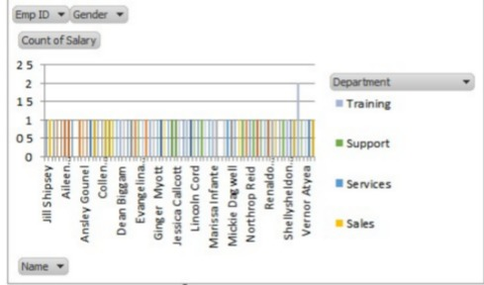
RESULTS 1. *Pay Equity Gaps*: Identification of gender, racial, or other demographic-based pay disparities.
11

Slide 12
Conclusion Salary and Compensation Analysis through Excel data modeling offers a powerful solution for organizations to optimize their compensation strategies. By leveraging Excel’s data modeling capabilities, organizations

